Slide 1
Predicting Airbnb prices in Washington D.C.
By: Daniel Park
danielp2@umbc.edu
DATA 606

Slide 2
What is Airbnb?
Internet marketplace for home and apartment rentals.
Typically cheaper than hotels.
Hosts who are willing to rent out their place chooses their own rate.
However, there is no easy way to determine the rate for their property.

Slide 3
Project Overview
Main Goal: Using Machine Learning to predict Airbnb prices in Washington D.C.
Using five methods: XGBoost, TLNN, TLNN with L1 Regularization, TLNN with L2 Regularization, and TLNN with Dropout Regulatization.

Slide 4
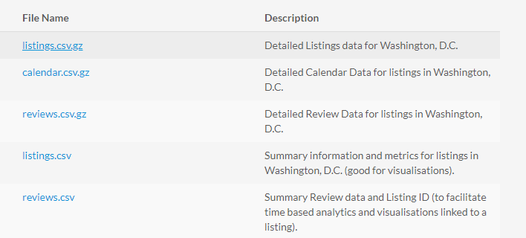
Datasets
http://insideairbnb.com/get-the-data.html

Slide 5
Features
accommodates: the number of guests the rental can accommodate
bedrooms: number of bedrooms included in the rental
bathrooms: number of bathrooms included in the rental
beds: number of beds included in the rental
price: nightly price for the rental
minimum_nights: minimum number of nights a guest can stay for the rental
maximum_nights: maximum number of nights a guest can stay for the rental
number_of_reviews: number of reviews that previous guests have left

Slide 6
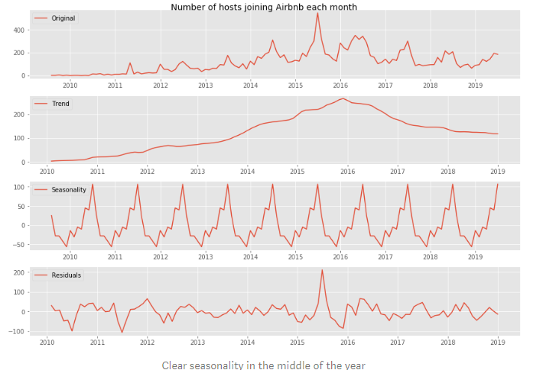
Similar Projects

Slide 7
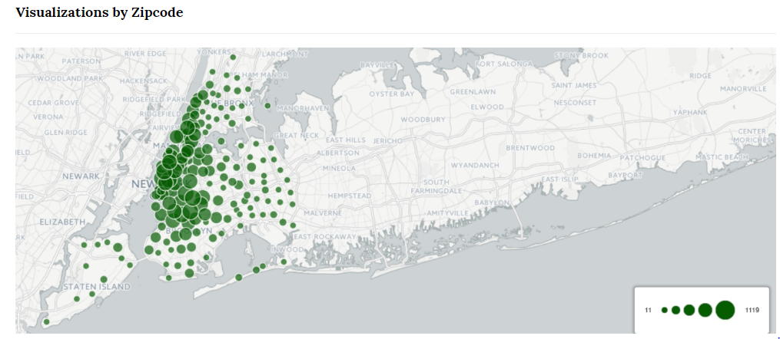
Similar Projects

Slide 8
Data Cleaning
Started with 106 columns and ended up with 23.
Removed rows that had inconsistent data and null values.
Organized property_type and amenities so that it will be easier to keep track of later on.
Used One Hot Encoding on categorical columns to make it easier for ML algorithms to read.

Slide 9
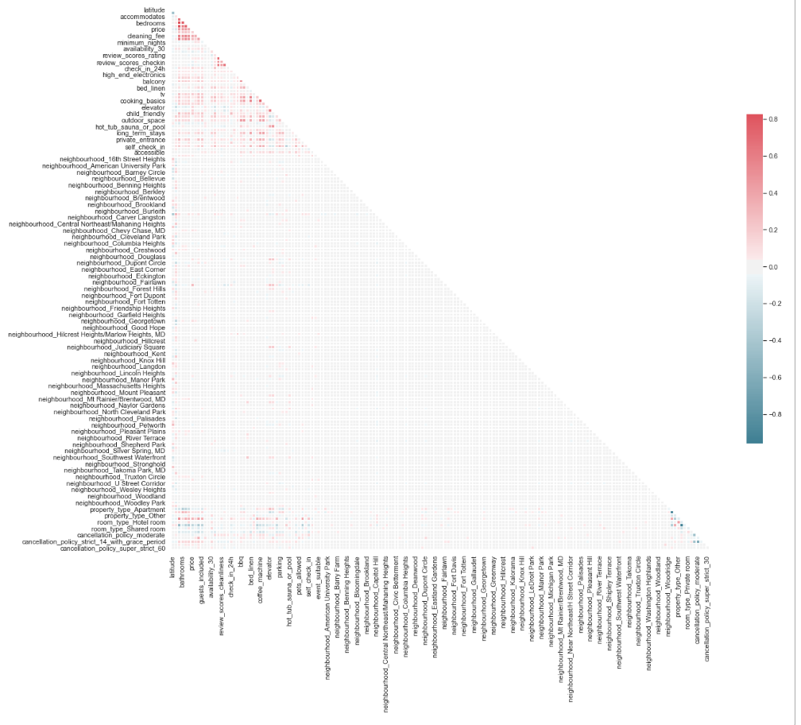
Data Exploratory Analysis

Slide 10
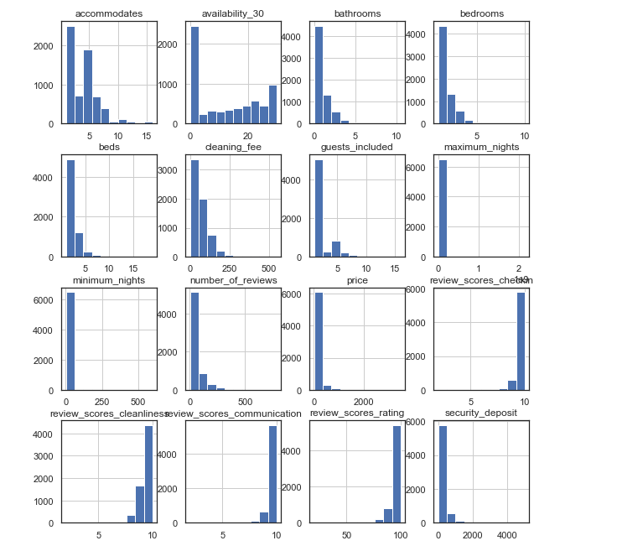
Data Exploratory Analysis

Slide 11
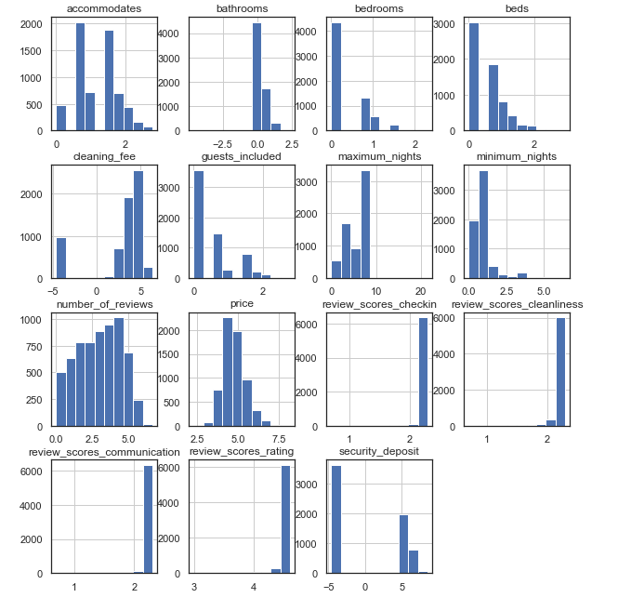
Data Exploratory Analysis

Slide 12
Implementation

Slide 13
XGBoost
Gradient Boosting algorithm that excels in execution speed and model performance.

Slide 14
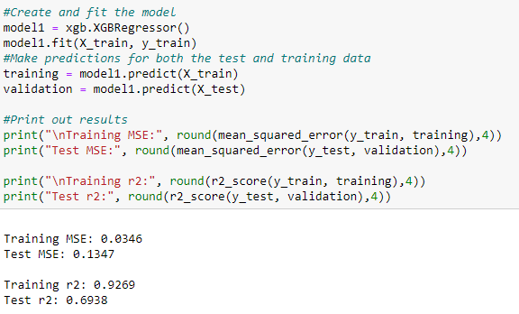
XGBoost

Slide 15
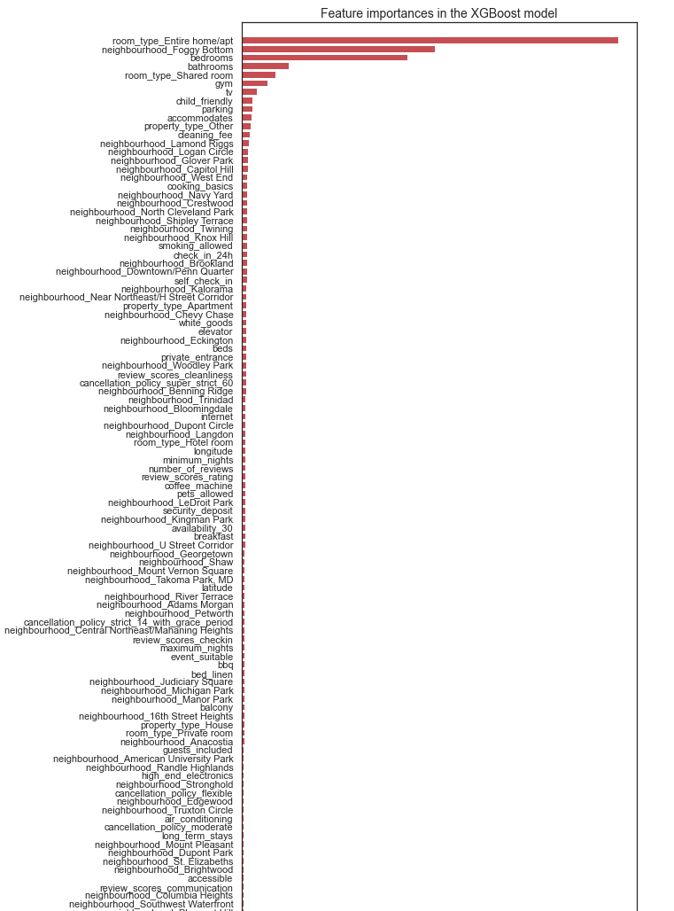
Feature Importance

Slide 16
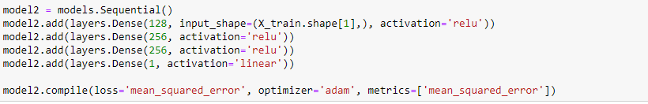
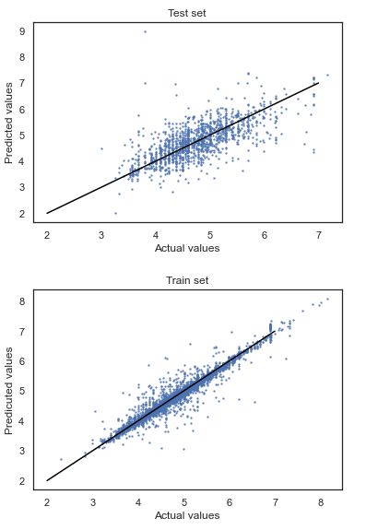
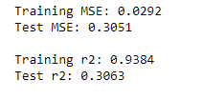
Three Layer Neural Network

Slide 17

Three Layer Neural Network with L1 Regularization
L1 Regularization is used to reduce overfitting and uses the function :
This function penalizes the absolute value of the weights, which is useful when trying to compress the model.
Source: https://www.analyticsvidhya.com/blog/2018/04/fundamentals-deep-learning-regularization-techniques/

Slide 18
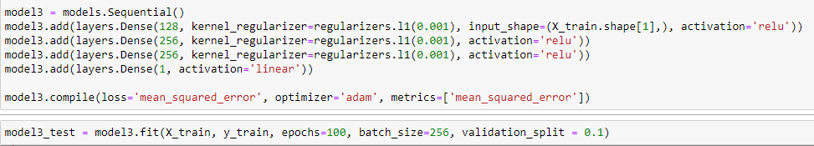
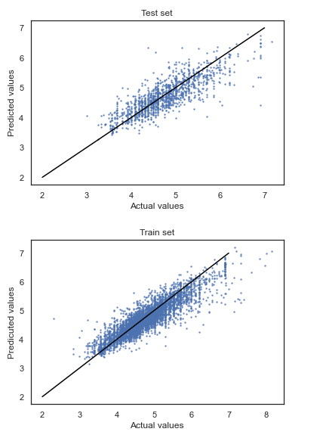
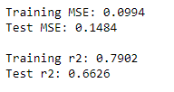
Three Layer Neural Network with L1 Regularization

Slide 19

Three Layer Neural Network with L2 Regularization
L2 Regularization is similar to L1 in terms of purpose, but the function is different:
L2 regularization is also known as weight decay as if forces the weights to decay towards zero
Source: https://www.analyticsvidhya.com/blog/2018/04/fundamentals-deep-learning-regularization-techniques/

Slide 20
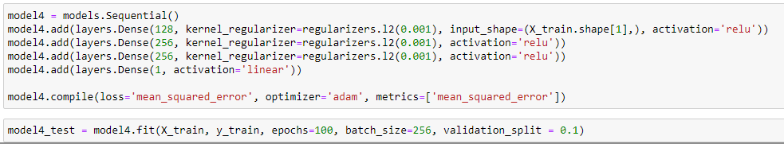
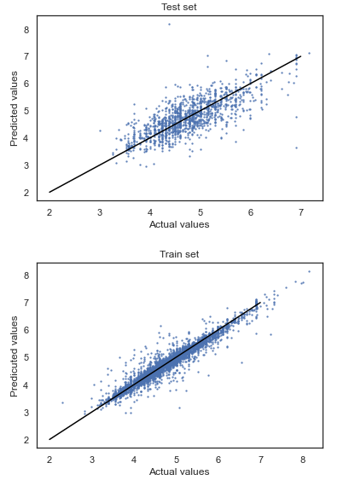
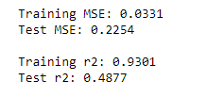
Three Layer Neural Network with L2 Regularization

Slide 21
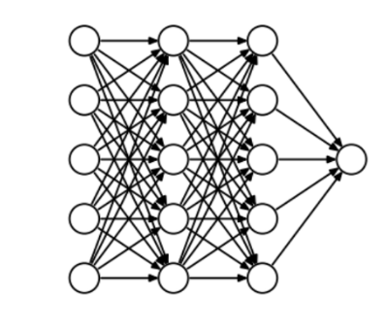
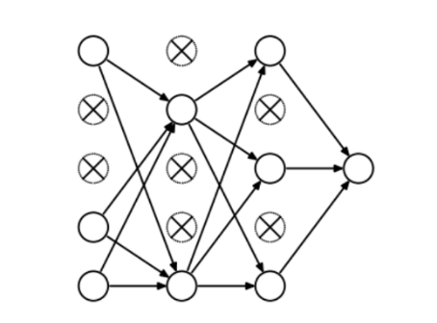
Three Layer Neural Network with Dropout

Slide 22
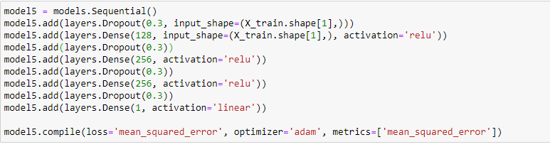
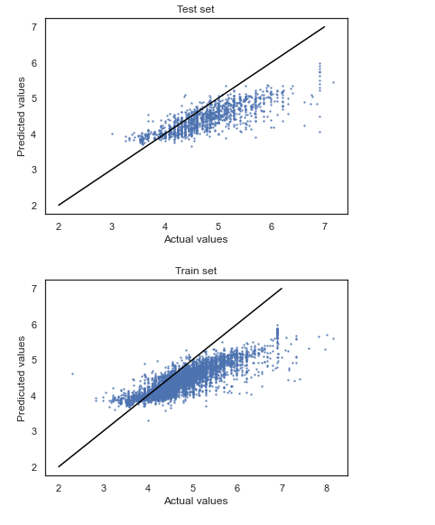
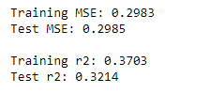
Three Layer Neural Network with Dropout

Slide 23
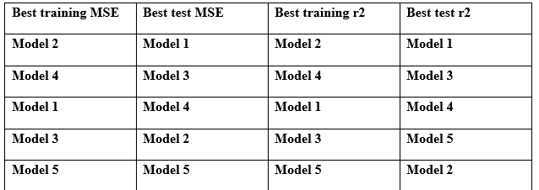
Conclusion
Model 1(XGBoost) performed the best out of all five models
It was only able to explain about 69% of the variation in price. The other 31% could have been from the dropped columns earlier.

